Slide 1


HACKED- 3.0: Edu-Flow
C-2 Hack Hustlers present: Edu-Flow. Streamlining class scheduling. Real-time updates. Eliminating miscommunication. Enhancing efficiency. Role-based authentication.
by BugGamer

Slide 2
Problem Statement
Inefficient Scheduling
No Cancellation System
Lack of Real-Time Updates
Manual systems are prone to errors. Labor-intensive.
Lack of a claiming free slots process.
Students and teachers get outdated info.

Slide 3




Edu-Flow Solution
Friendly Interface
Real-Time Updates
Role-Based Authentication
Easy scheduling and management.
Notifications for schedule changes.
Specific student and teacher access.

Slide 4

Key Features
Students
Schedule management
Class change updates
Teachers
Class cancellation
Free slot release
Claim available slots

Slide 5
Workflow
Login
1
Student/Teacher logs in
2
Timetable
Input timetable
Updates
3
Teacher updates/cancels
4
Claim
Teacher claims slots
Notify
5
System notifies changes

Slide 6

Edu-Flow Benefits
1
Enhanced Communication
2
Efficient Scheduling
Easy class management and cancellation.
Real-time updates reduce miscommunication.
3
Improved Transparency
Role-based access ensures data integrity.

Slide 7
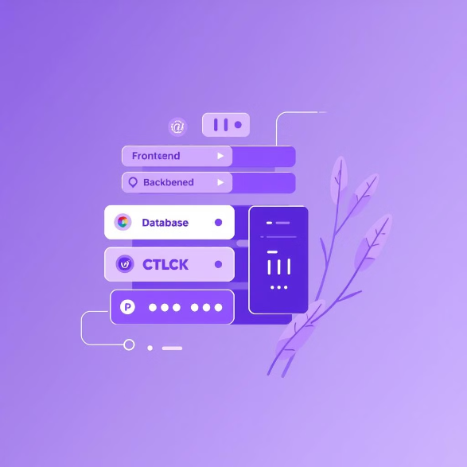
Tech Stack
Frontend: HTML, CSS, JavaScript - for a dynamic user interface.
Backend: Node.js, Express.js - handles server-side logic.
Database: MongoDB Atlas - a scalable cloud database.
Authentication: JWT - ensures secure user authentication.
Tools & Libraries: Firebase, Nodemon, bcrypt.js, CORS - supporting development and security.

Slide 8

Video Demo
See Edu-Flow in action. Watch our video.

Slide 9

Thank You
Questions? Contact us!

